Slide 1
Machine Learning Algorithms
Master’s in Applied Artificial Intelligence
Luís Ferreira
lufer@ipca.pt

Slide 2
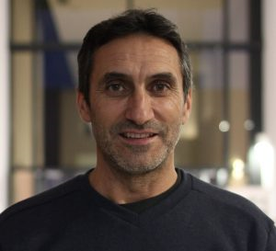
Machine Learning Algorithms
Luís Ferreira
Background: Mathematics and Computer Sciences;
Office: 5
Email/web: lufer@ipca.pt; https://2ai.ipca.pt/luis-ferreira/
Available on:
  Office: Tuesday: 17.00-18.00h
  zoom: https://videoconf-colibri.zoom.us/my/lufer Monday: 21.00h-22.00h
  Github: https://github.com/luferIPCA/MLA-23-24.git and Moodle, as well!
Notes:
PHD: Doctoral Programme in Industrial and Systems Engineering (PISE)

Slide 3
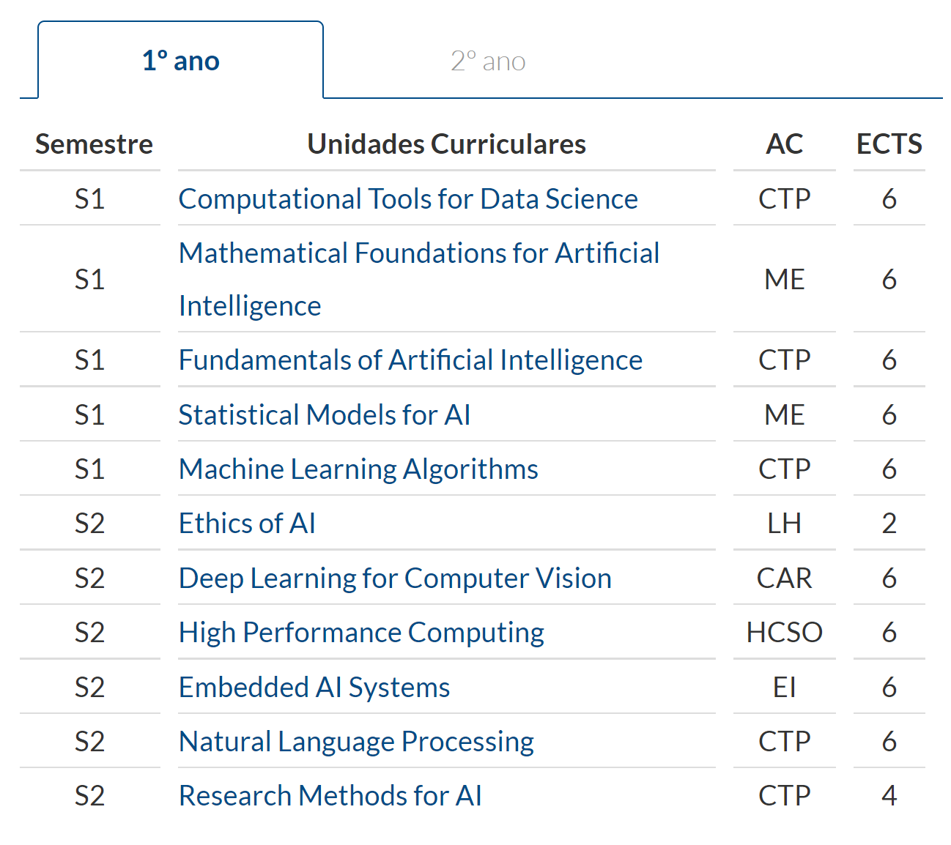
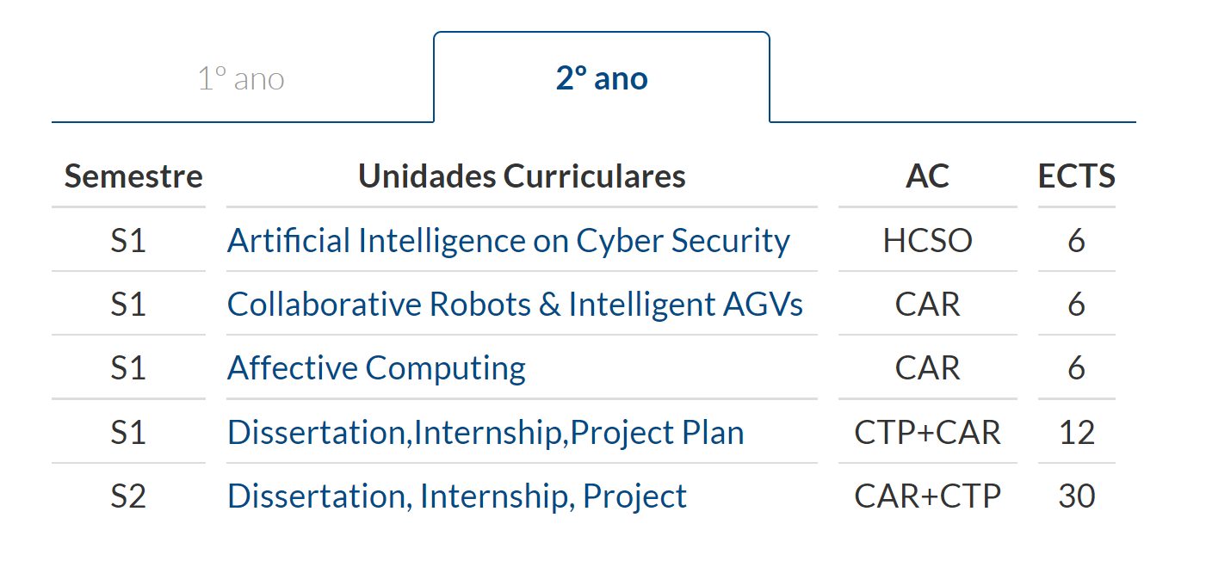
Machine Learning Algorithms

Slide 4
Machine Learning Algorithms
Poll on course schedule!
Lecture
Lecture
Lecture
Practice
Break
Practice
Break
Practice
Break
Lecture
(A)
(B)
(C)

Slide 5
Overview
Part I
Artificial Intelligence and Machine Learning
Foundations
Part II
Machine Learning
Concepts and Options
Part III
Machine Learning Algorithms
Parte IV
Machine Learning Algorithms (Adv.)
Parte V
Deep Learning & Neural Networks

Slide 6
Machine Learning Algorithms
Competencies to be acquired:
Concepts understanding…essential (what?)!
Context perception…critical (where?)!
Knowledge application and demonstration…objective goal (How)!

Slide 7
Requirements and Marking
(5%) Read some classic papers
  Write short summarizing paper
(25%) “exam” held during normal class time
  Exploring a problem; propose a ML solution architecture
(70%) Project
  Explore a problem, design a ML architecture solution, implement, analyse results, write short report, ?public presentation (…more details later)

Slide 8
More on Assignments
Collaboration on the assignments is not allowed. Each student is responsible for his/her own work. Discussion of assignments should be limited to clarification of the handout itself and should not involve any sharing of pseudocode or code or simulation results. Violation of this policy is grounds for a semester grade of F, in accordance with polytechnic regulations.
The schedule of assignments will be posted on the course supporting system (moodle).

Slide 9
More on Assignments
Assignments should be handed in by deadline; a late penalty of 10% per day will be assessed thereafter (up to 3 days, then submission is blocked).
Extensions will be granted only in special situations, and you will need to complete an absence declaration form and notify us to request special consideration, or otherwise have a written request approved by the course instructors at least one week before the due date.

Slide 10
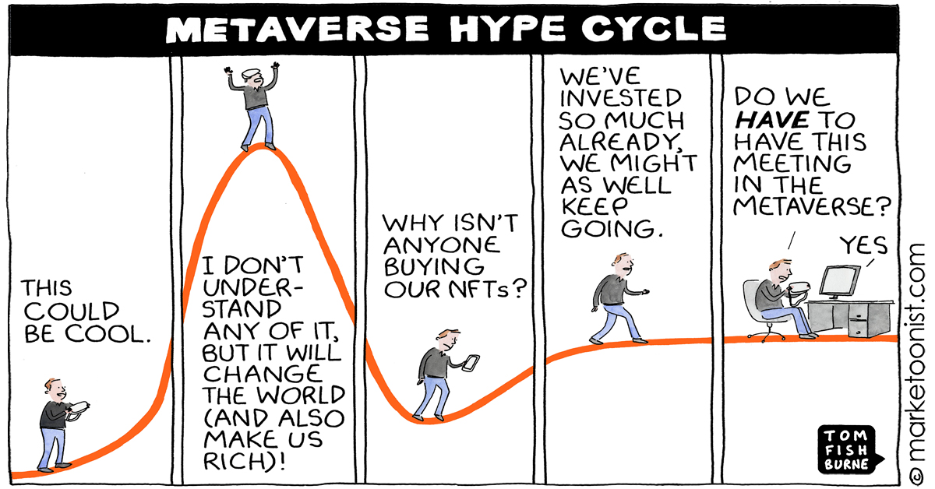
Machine Learning Algorithms

Slide 11
References
Machine Learning, Tom M. Mitchel, McGraw-Hill, 1997
Artiﬁcial Intelligence, A Modern Approach Third Edition, Stuart J. Russell and Peter Norvig, Prentice Hall, 2010
Machine Learning Tutorial
  https://www.simplilearn.com/tutorials/machine-learning-tutorial/machine-learning-steps
More Material
  https://github.com/josephmisiti/awesome-machine-learning/blob/master/books.md

